Slide 1
Automation of API Validation
By
Ajay Singh Bhatia

Slide 2
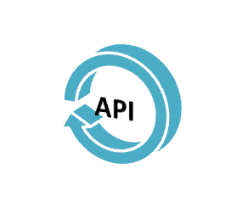
What is API Validation
API validation is a type of software testing that involves testing application programming interfaces (APIs) directly and as part of integration testing to determine if they meet expectations for functionality, reliability, performance, and security.
REST support XML, Json or exchange of data in simple URL.

Slide 3

Postman is a Google Chrome app for interacting with HTTP APIs.
It presents you with a friendly GUI for constructing requests and reading responses.
Postman can run GET, PUT, POST and various other request methods as well, and also has utilities to help with developing APIs.
Put the url address into the address bar where API is deployed
Update the client ID for which you are testing (North America or International)
Update the JSON body if any
And press the SEND button, the postman will return the execution response and status code of execution.

Slide 4


Slide 5

A lot of manual effort is wasted.
Time consuming.
Execution is done one by one.
Roughly 15 man days of effort is spent in a week for validation. Which include bandwidth of 3 senior Business Consultants.

Slide 6


Slide 7


Slide 8

Validating Using Scripting
We can validate the API using this script.
The script will communicate with the server directly and complete the execution.
No manual effort is required.
Output will be generated in an excel sheet.
Execution result of the test cases will be compared to those checked in by the developer.
If test case fails, expected and execution result will be printed, which then can be manually executed

Slide 9

Quick and Fast
High throughput
Scripts supports all the methods.
Will help us to speed up the validation process.
Will save manual efforts

